Slide 1


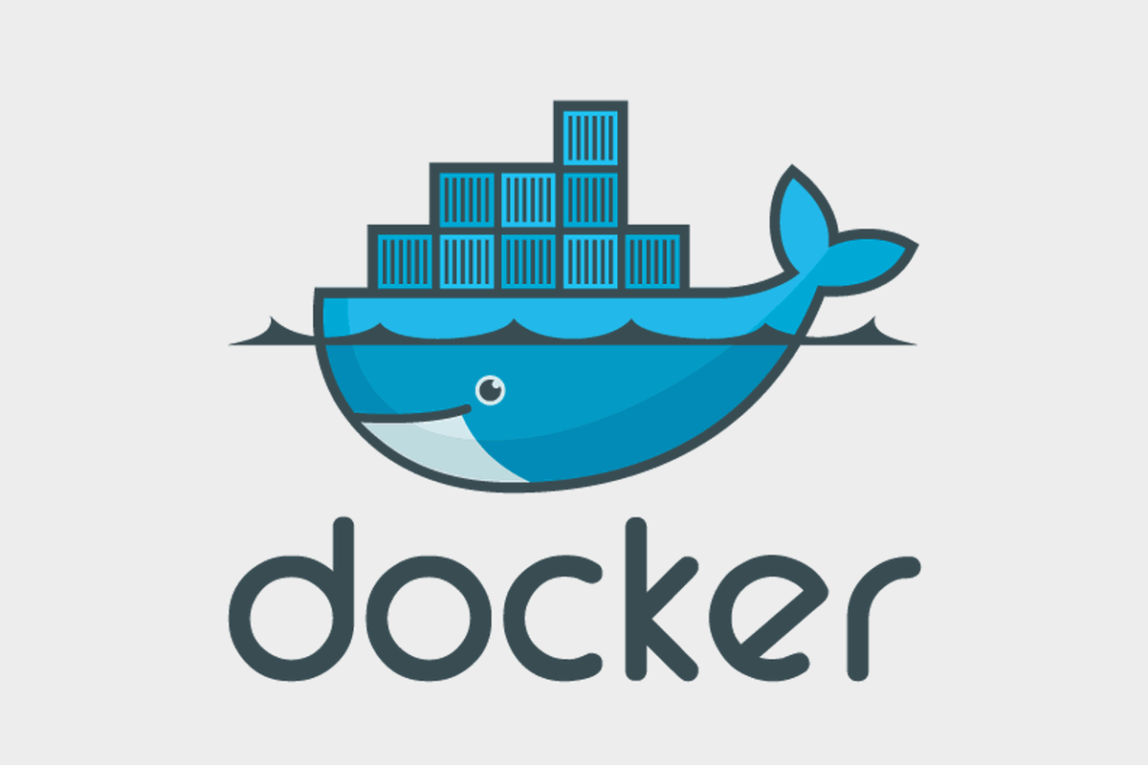

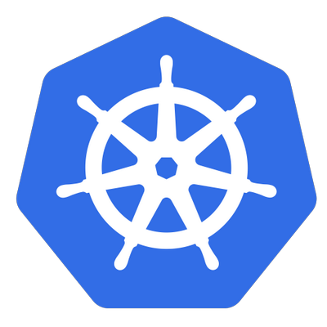

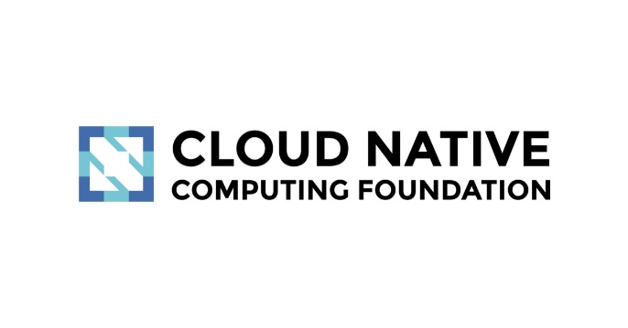

KUBERNETES
From Container to CaaS
BAO HUYNH (LDE)
10/10/2018

Slide 2
AGENDA
CONTAINER RECALL
KUBERNETES – A RISING HERO
K8S ARCHITECTURE
KEY CONCEPTS
DEMOS

Slide 3
AGENDA
CONTAINER RECALL
Microservice & Container approach
Docker
KUBERNETES – A RISING HERO
K8S ARCHITECTURE
KEY CONCEPTS
DEMOS

Slide 4
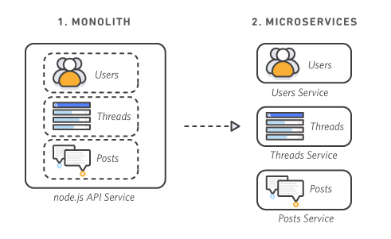

I.CONTAINER RECALL

Slide 5
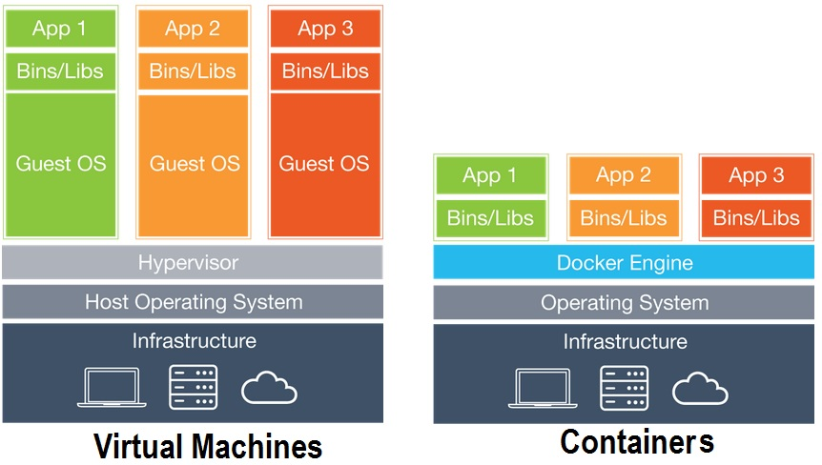
I.CONTAINER RECALL

Slide 6
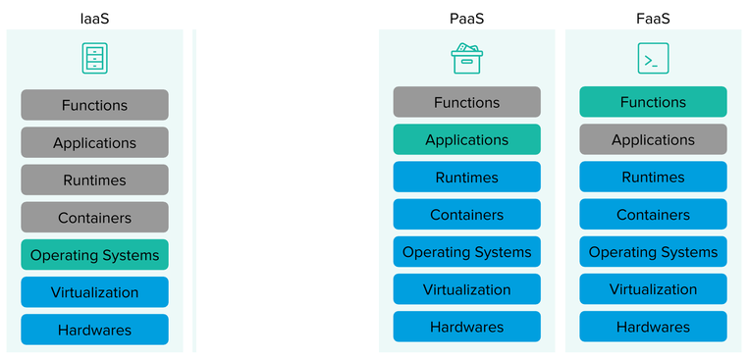
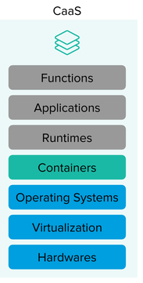
I.CONTAINER RECALL
CaaS (Container as a Servicer)

Slide 7
AGENDA
DOCKER RECALL
KUBERNETES – A RISING HERO
Kuber-what ?
Why Kuberenetes
K8S ARCHITECTURE
KEY CONCEPTS
DEMOS

Slide 8
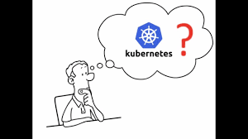

II.KUBERNETES – A RISING HERO
“Kubernetes is an open-source platform for :
- automating deployment - scaling
- operations of containers
across cluster of host
providing container-centric infrastructure”
- from Kubernetes’ father with love -

Slide 9
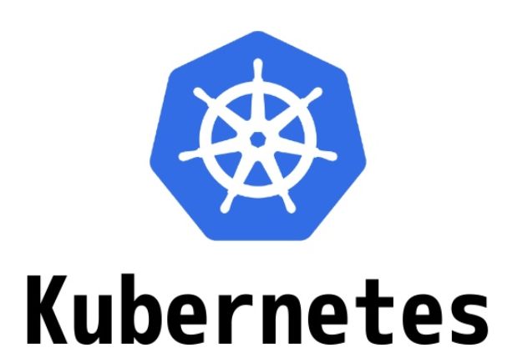
II.KUBERNETES – A RISING HERO

Slide 10
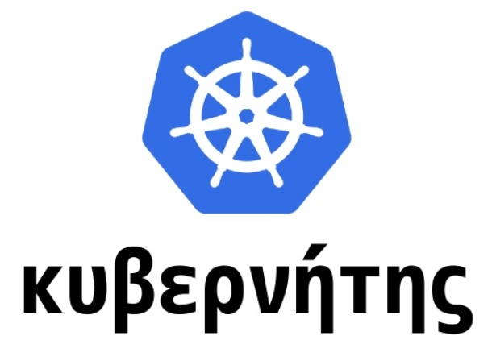

II.KUBERNETES – A RISING HERO
/ CU-BÉ NÉ-ĐỊT /

Slide 11
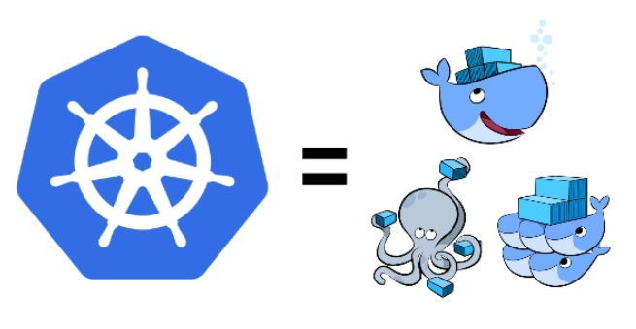
II.KUBERNETES – A RISING HERO

Slide 12
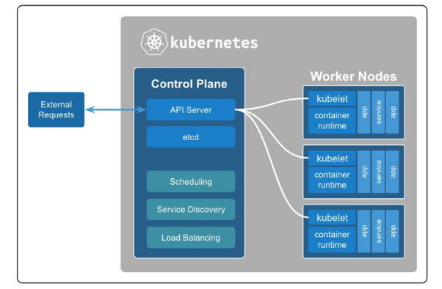
II.KUBERNETES – A RISING HERO

Slide 13
KUBERNETES, WHY ?
II.KUBERNETES – A RISING HERO
VM1
# ssh root@VM1
# docker run nginx –p 8080:80 …
VM2
# ssh root@VM2
# docker run nginx –p 8080:80 …
…...
…...
…...

Slide 14
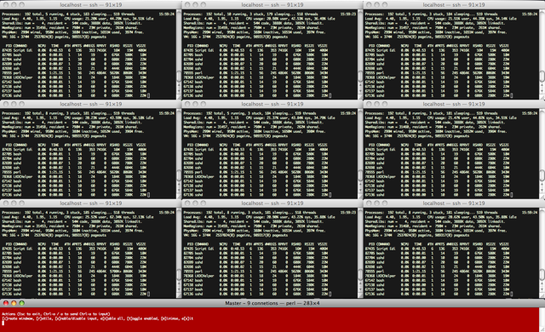

KUBERNETES, WHY ?

Slide 15
II.KUBERNETES – A RISING HERO
Deployment/Provision one or multiple containers
Replicas of containers on multihost
Data volumes for persistent storage management
Multihost Overlay networking
……..
KUBERNETES, WHY ?

Slide 16
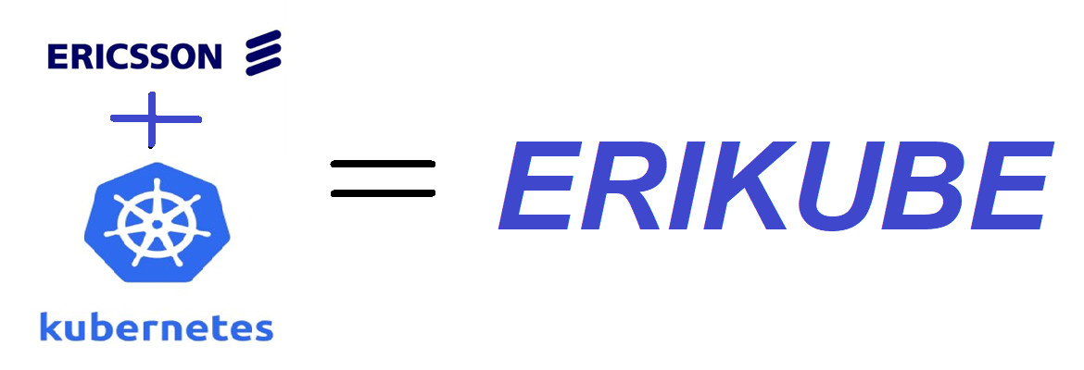
KUBERNETES, WHY ?

Slide 17
AGENDA
DOCKER RECALL
KUBERNETES – A RISING HERO
K8S ARCHITECTURE
Master node
Worker node
Additional Services
KEY CONCEPTS
DEMOS

Slide 18
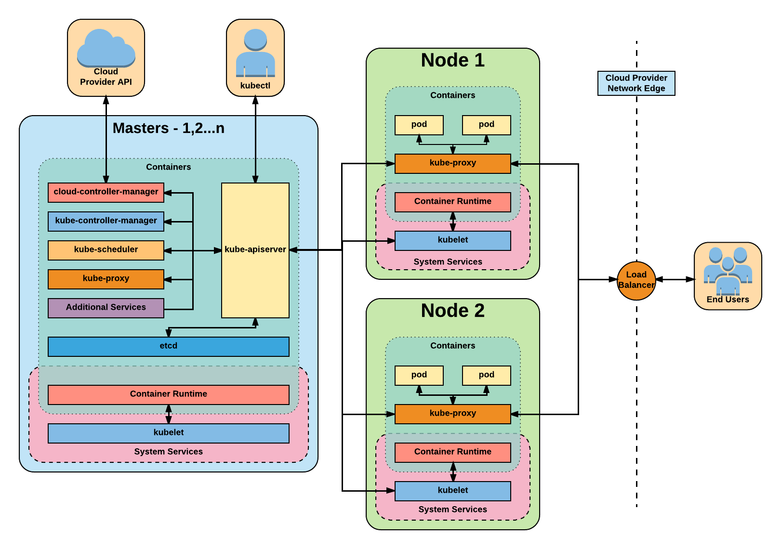
Architecture Overview

Slide 19
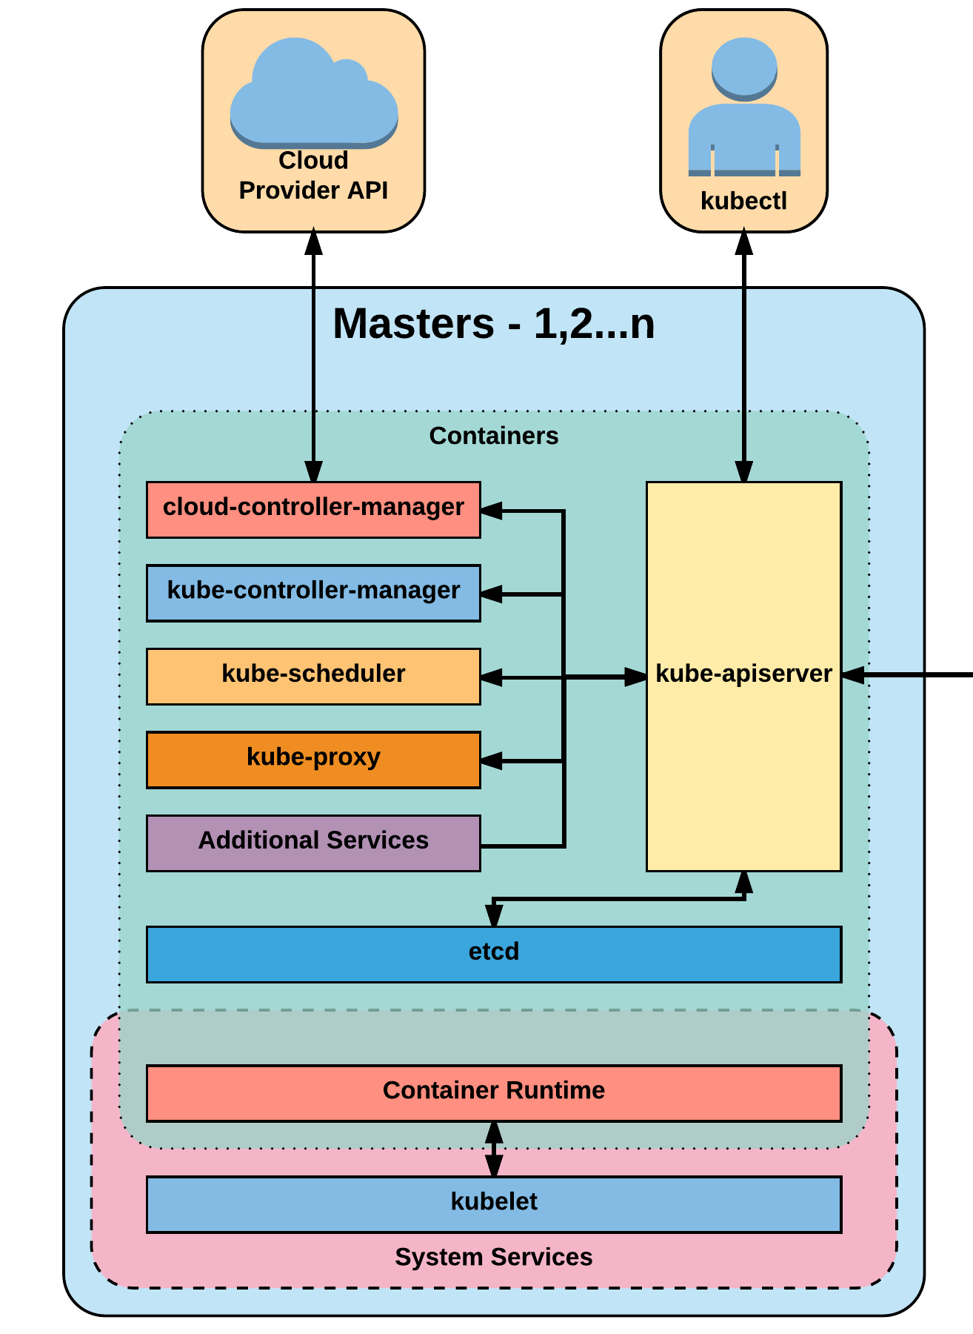
Master (Control plane for Kubernetes)
III. K8S ARCHITECTURE
kube-API Server: gatekeeper to handle HTTP request between control plan & workers.
kube-Scheduler: evaluates workload and place it on a matching resource
kube-Cluster controller: manages all core component control loops:
- Monitors the cluster state via the apiserver
- Steers the cluster towards the desired state with
cloud-provider (AWS, GCP, Azure,..) component.
etcd: provide highly available key-value database

Slide 20
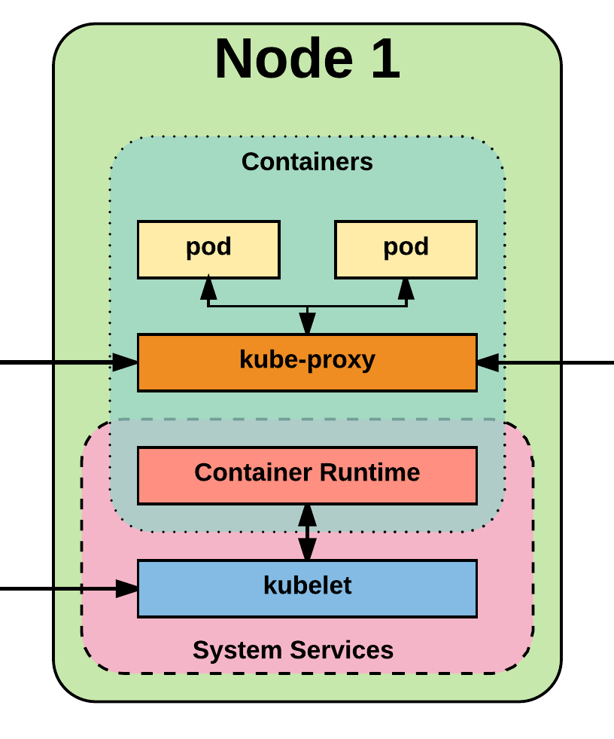
Nodes/Workers
III. K8S ARCHITECTURE
the ‘place’, where pod/containers run on,
care ‘workload’ of cluster
Daemon:
- kubelet: managing pod lifecycle on its
host + interact with APIServer (master)
- kube-proxy: load balancing/connection
forwarding between pods.

Slide 21
Additional Services
III. K8S ARCHITECTURE
Kube-dns - Provides cluster wide DNS Services. Services are resolvable to <service>.<namespace>.svc.cluster.local.
Heapster - Metrics Collector for kubernetes cluster, used by some resources: Horizontal Pod Autoscaler or Dashboard Metrics,…
Kube-dashboard - A general purpose web based UI for kubernetes.

Slide 22
AGENDA
DOCKER RECALL
KUBERNETES – A RISING HERO
K8S ARCHITECTURE
KEY CONCEPTS
Pod/Deloyment/Service
Storage
ConfigMap/Secret
Authentication and Identity with RBAC
Networking
DEMOS

Slide 23
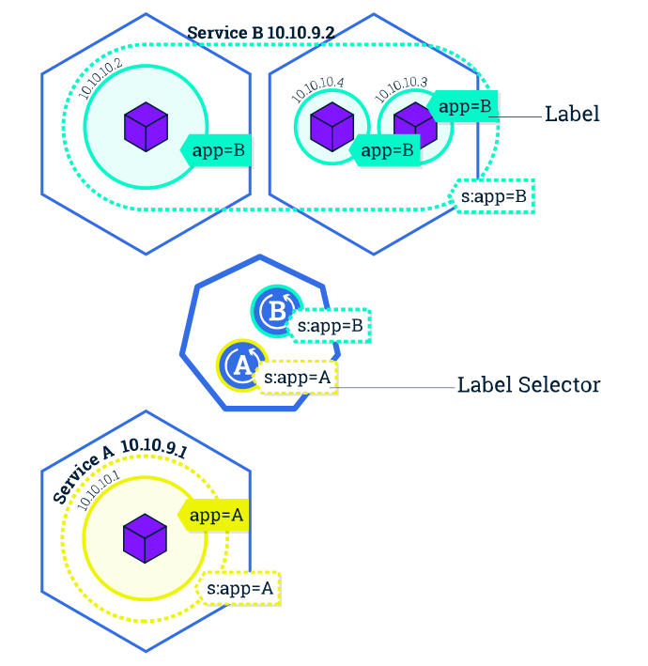
POD *
DEPLOYEMENT *
SERVICE *

Slide 24
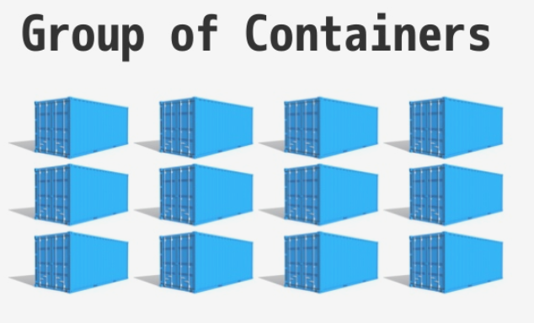
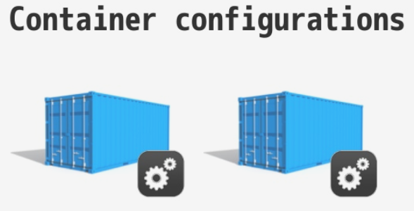
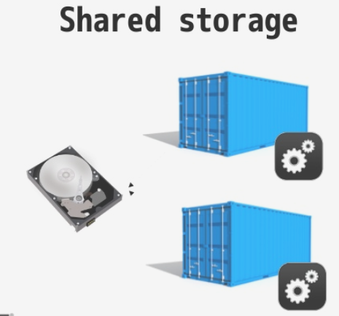
IV. KEY CONCEPTS (Pod)
Pod - A pod is the smallest unit of work/management resource within Kubernetes.
Pods comprise of:

Slide 25
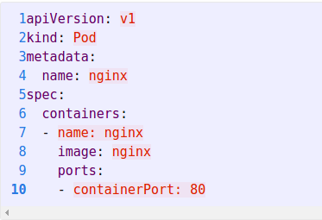
IV. KEY CONCEPTS (Pod)
Pod - example manisfest

Slide 26
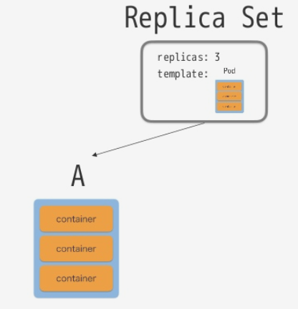
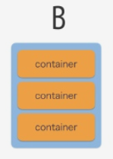
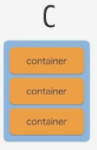
IV. KEY CONCEPTS (Deployement)
ReplicationController – keeps track of pod replicas and their lifecycle.
ReplicaSet - Next Generation ReplicationController. Supports set-based selectors.
Notes:
The Pod is the atomic unit of k8s -- in the Deployment on the previous side, the Pod was in the spec.template

Slide 27
IV. KEY CONCEPTS (Deployement)
Deployment
Type of replicaton - backed by ReplicaSets
Keeps track of state change history
Provides scaling/update/rollback functionality
Notes:
The Pod is the atomic unit of k8s -- in the Deployment on the previous side, the Pod was in the spec.template

Slide 28
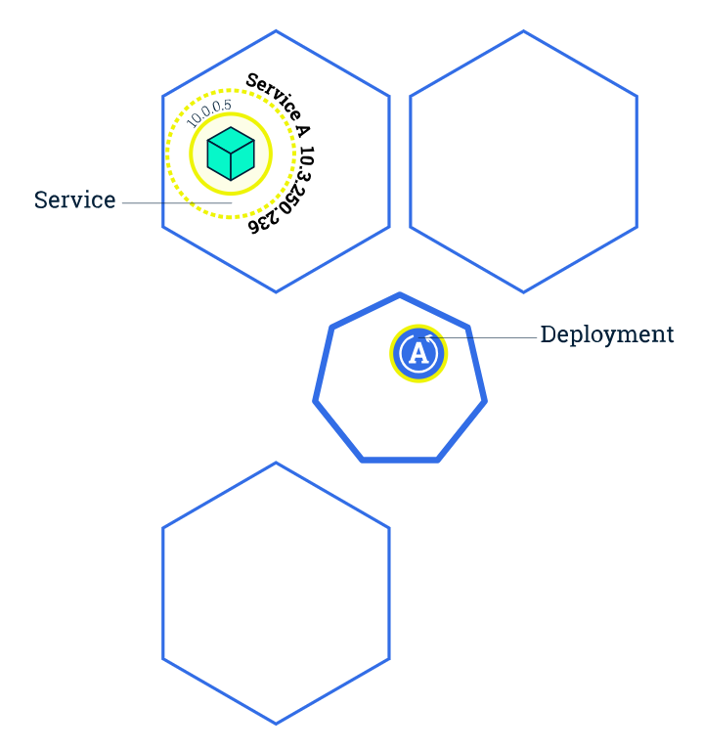
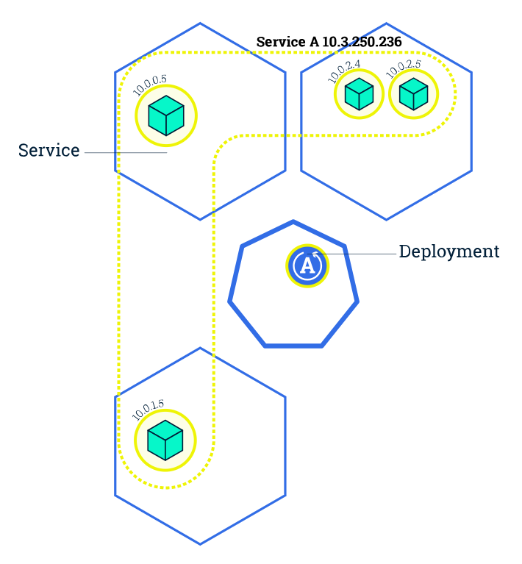
IV. KEY CONCEPTS (manual scaling deployment)
SCALING
Notes:
The Pod is the atomic unit of k8s -- in the Deployment on the previous side, the Pod was in the spec.template

Slide 29
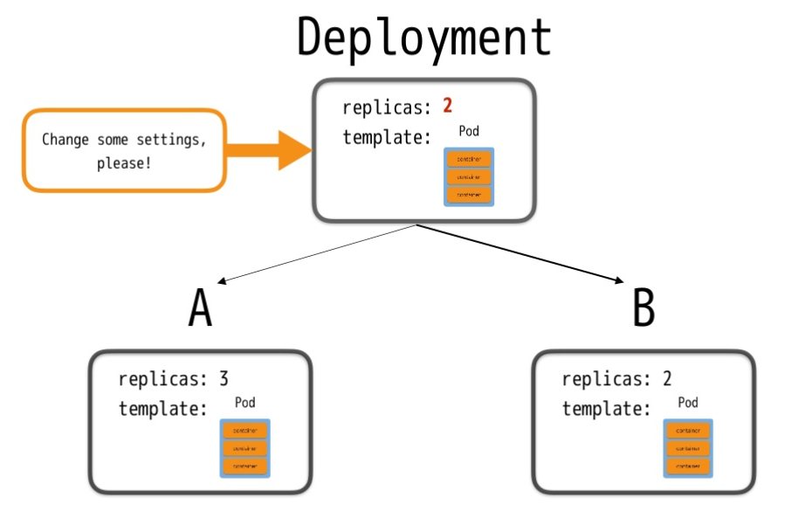

IV. KEY CONCEPTS (Deployement update 1/3)
Notes:
The Pod is the atomic unit of k8s -- in the Deployment on the previous side, the Pod was in the spec.template

Slide 30
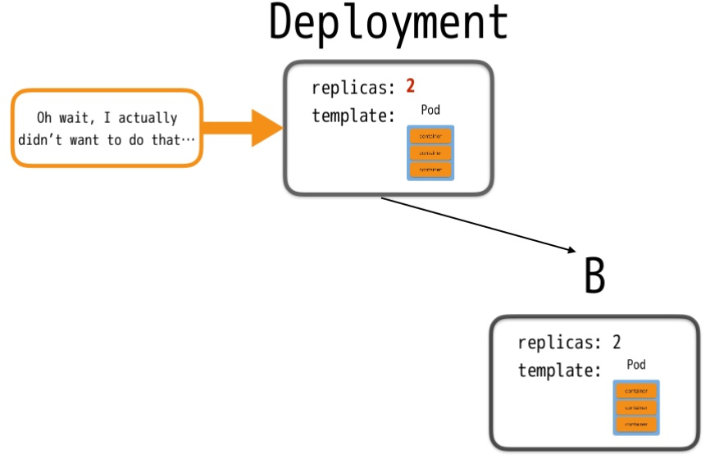
IV. KEY CONCEPTS (Deployement update 2/3)
Notes:
The Pod is the atomic unit of k8s -- in the Deployment on the previous side, the Pod was in the spec.template

Slide 31
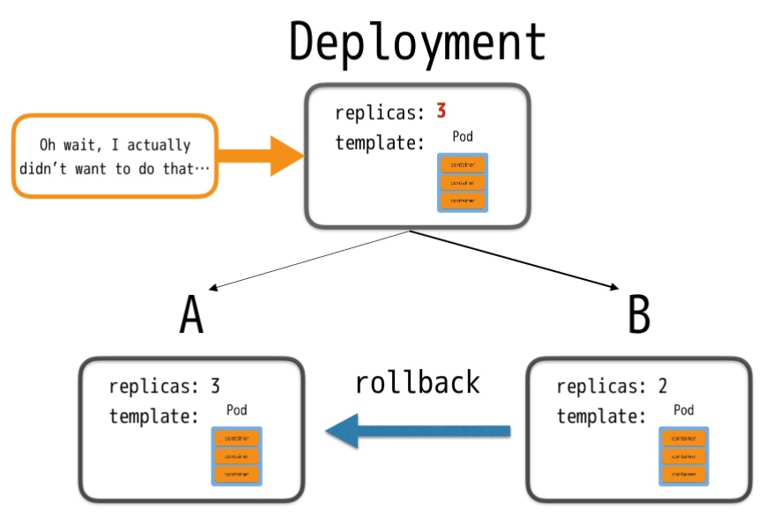
IV. KEY CONCEPTS (Deployement rollback 3/3)
Notes:
The Pod is the atomic unit of k8s -- in the Deployment on the previous side, the Pod was in the spec.template

Slide 32
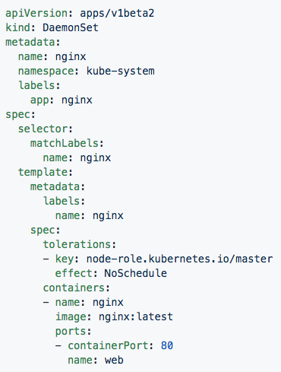
IV. KEY CONCEPTS (DaemonSet)
DaemonSet - Pod will run on all healthy nodes (Bypasses default schedule)
Use case: Ideal for cluster wide services such as log forwarding, or health monitoring.

Slide 33
IV. KEY CONCEPTS (Deployment Summary)
 | Node Scope | Scaling/Update/Rollback | Label-Selector support
ReplicationController | One/Multiple/All | No | No
ReplicationSet | One/Multiple/All | No | Yes
Deployment | One/Multiple/All | Yes | Yes
DaemonSet | All (mandatory) (by pass scheduler) | No | Yes

Slide 34
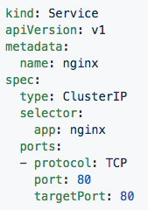
Service
IV. KEY CONCEPTS (Service)
Logical set of Pods (and ways to access them)
Four major Service Types:
CluterIP – internal access only
NodePort – external access via port on host (mapping port containter = port on host)
LoadBalancer – external access via a loadBalancer static IP (created by AWS, GCP,…
ExternalName - used to references endpoints OUTSIDE the cluster by providing a static internally referenced DNS name.
Notes:
Port: Port of internal ClusterIP → curl <clusterIP>:1234
Target Port: Target port is the port on the POD where the service is running.
Nodeport: Node port is the port on host (used along with external IP) → curl <externalIP_of_node>:33569

Slide 35
Put things together (Pod + Deployment + Service)

Slide 36

IV. KEY CONCEPTS (Pod/Deployement/Service)
Notes:
Daemonsets are things that are tied to nodes, things that should run on every node or subset of every node
There isn’t much different from them and a replicaset in how a user interacts with them, but much on the backend and how things are scheduled

Slide 37
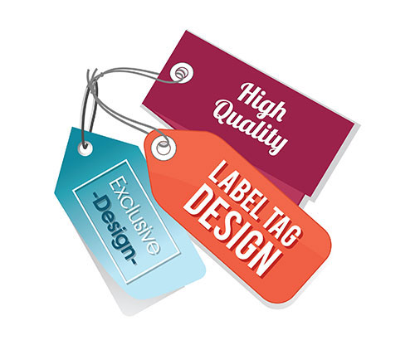
LABEL &
SELECTOR

Slide 38
IV. KEY CONCEPTS (labels & selector)
Label - Key-value pairs that are used to identify, describe and group together related sets of objects.
Selector - Selectors use labels to filter/select objects. Support 2 kinds of selection:
Equality-based selector: (=, ==, !=)
Set-based selector: ( In, NotIn, Exists, DoesNotExist )
Notes:
Labels, Annotations, and Selectors are heavily used in K8s
Part of the design principles of kubernetes was being able to reference other objects without having to know the object’s name directly and all these play into it
Annotations are used quite a bit by various extensions for additional config information

Slide 39
IV. KEY CONCEPTS (labels & selector)
Notes:
Labels, Annotations, and Selectors are heavily used in K8s
Part of the design principles of kubernetes was being able to reference other objects without having to know the object’s name directly and all these play into it
Annotations are used quite a bit by various extensions for additional config information

Slide 40
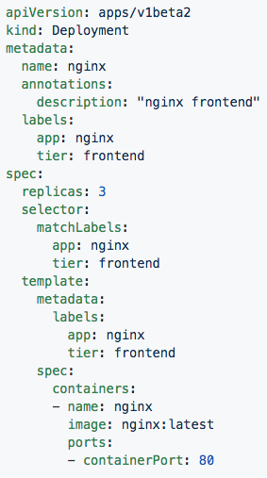
Equality-based selectors
IV. KEY CONCEPTS (labels & selector)
Labels:
app: nginx
tier: frontned
Annotations
description: “nginx frontend”
Selector:
app: nginx
tier: frontend
Notes:
In this both the Deployment and Pod are labeled with app:nginx, tier: frontend
The replicaset definition targets them with simple selectors matching the key-value pairs of both app:nginx and tier: frontend

Slide 41
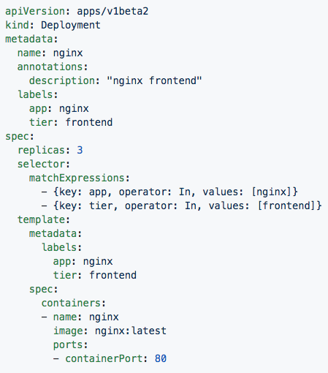
Set-based selectors
IV. KEY CONCEPTS (labels & selector)
Valid Operators:
In
NotIn
Exists
DoesNotExist
Supported Objects with set-based selectors:
Job
Deployment
ReplicaSet
DaemonSet
PersistentVolumeClaims
Notes:
Set-based selectors are a bit more advanced allowing you to match against possible values and use some boolean logic
Only a subset of objects support these set-based selectors

Slide 42
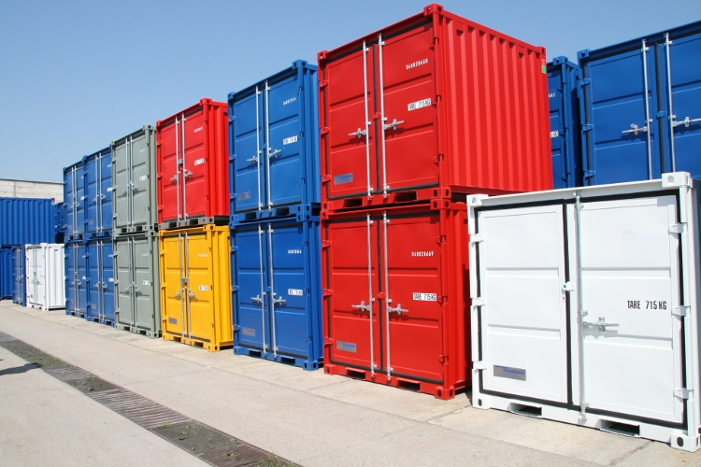
STORAGE

Slide 43
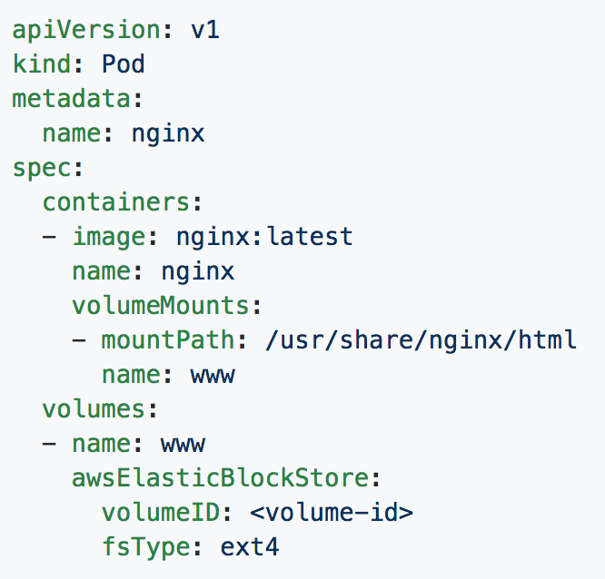
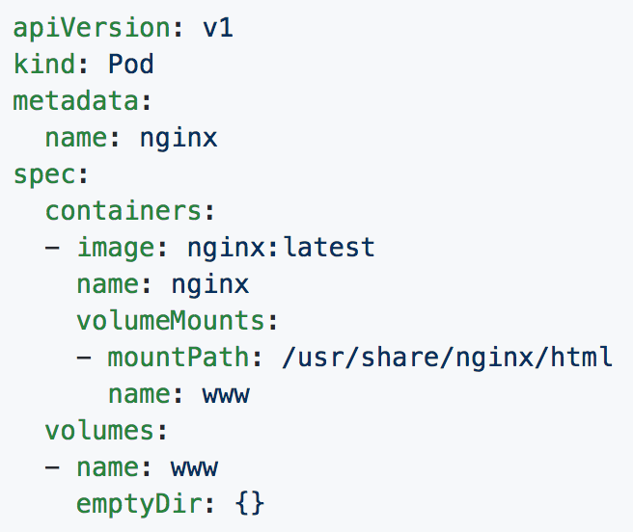
IV. KEY CONCEPTS (Storage)
Volume - Storage that is tied to the Pod Lifecycle, consumable by one/more containers within the pod (local resource)
Notes:
EmptyDir: initially empty When a Pod is removed from a node for any reason, the data in the emptyDir is deleted forever.

Slide 44
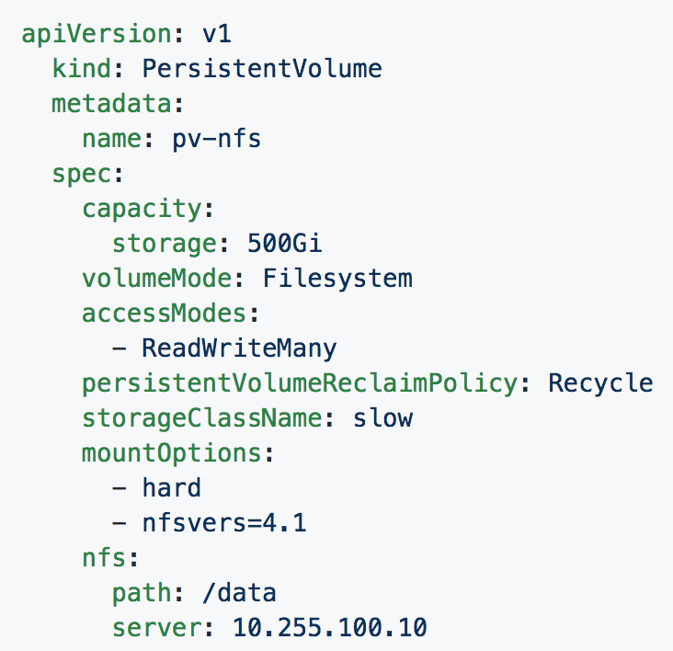
IV. KEY CONCEPTS (Storage)
PersistentVolume (PV) - represents a external resource (linked to a backing storage resource: NFS, GCEPersistentDisk, EFS,..).
Lifecycle are provisioned ahead of time & independently from a pod.
Notes:
Things can get a little confusing here, big thing to note:
A volume in a pod definition is tied to the pods lifecycle, it dies when the pod dies
A PV is a cluster-wise resource, usually some external storage system.
A PVC maps to a request for storage from a PV or StorageClass.

Slide 45
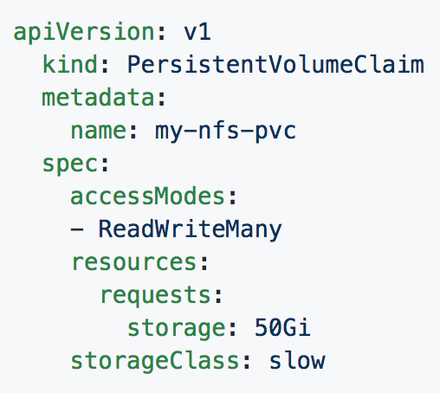
IV. KEY CONCEPTS (Volume-Claim)
PersistentVolumeClaim
mapping PV to pod’s storage.
PVCs are scoped to namespaces
Supports accessModes like PVs

Slide 46
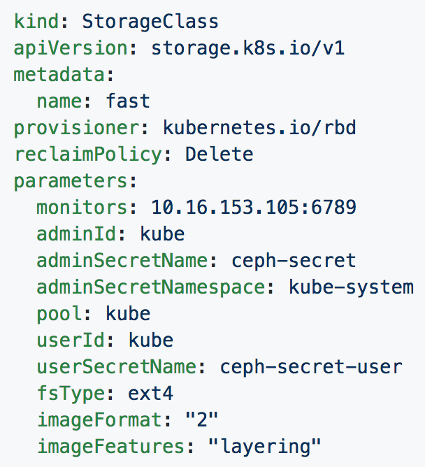
IV. KEY CONCEPTS (Storage class)
Abstraction on top of Persisten Volume with configuration
Uses an external system defined by the provisioner to dynamically consume and allocate storage.
Storage Class Fields
Provisioner
Parameters
reclaimPolicy

Slide 48

CONFIGMAP
&
SECRET

Slide 49
IV. KEY CONCEPTS (ConfigMap/Secret)
ConfigMap - shared variable/value between pods.
Could be retrieved by 2 ways:
Pod’s Environment variable
Volume mount
Secret - Functionally identical to ConfigMaps, but stored encoded as base64, and encrypted at rest (if configured).
Notes:
Note the base64 thing with secrets

Slide 50
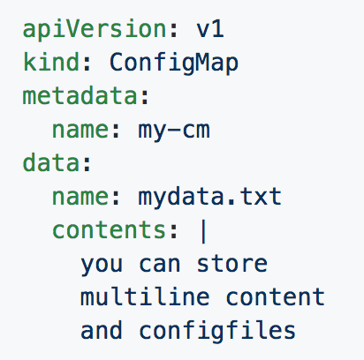
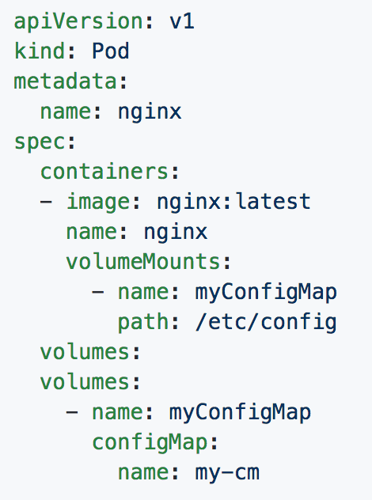
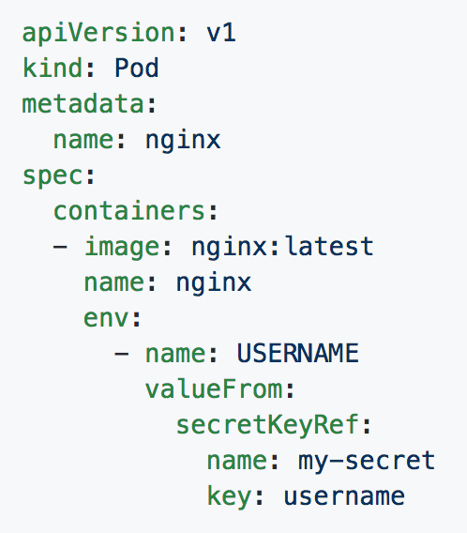
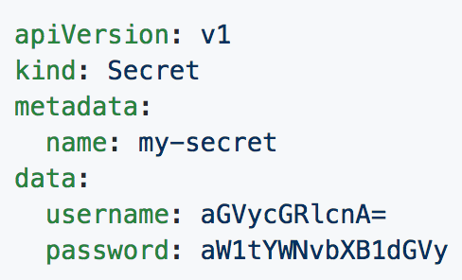
IV. KEY CONCEPTS (ConfigMap/Secret)
Can be used in Pod Config:
Injected as a file in Volume Mount
Passed as an environment variable
Notes:
Top right is a confgmap
Bottom right is a secret
Bottom left passes it to a volume
Bottom middle injects it as an env var

Slide 51

AUTHENTICATION
WITH RBAC
(role-based access control)

Slide 52
K8S AUTHENTICATION MODEL
IV. KEY CONCEPTS (RBAC)
(defined at Pod)
transfer
ServiceAccount
Pod’s Token
WORKER NODE
API Server
Role/ ClusterRole
RoleBinding/ ClusterRoleBinding
(Authencate via RBAC plugin)
(What-to-do) (ex: HTTP request GET,POST,PUSH,DELETE
(Who-will-do)
MASTER NODE
Notes:
ServiceAccount- ServiceAccounts provide a consumable identity for pods or external services that interact with the cluster directly and are scoped to namespaces.

Slide 53
Architecture Overview
Notes:
One big thing to note in this diagram - In most deployments, all of these services themselves run in as containers outside of kubelet.

Slide 54
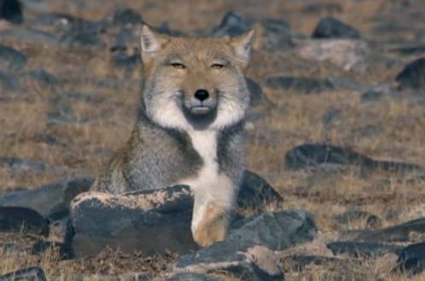
Who am I ???
Why am I here ???
Notes:
Note the base64 thing with secrets

Slide 55
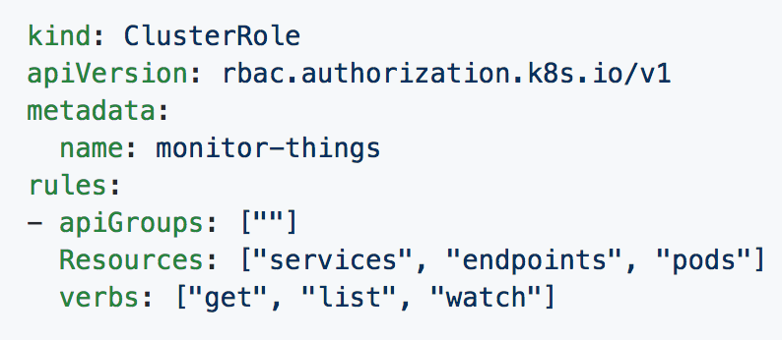
[Cluster]Role
IV. KEY CONCEPTS (RBAC)
Manage Resource Permissions
Resources: target (pods/deployment/…)
Verbs: actions (get/list/watch/…)
Notes:
If specifying a role and not a clusterrole, you must specify a namespace
This clusterrole can perform get/list/watch on services, endpoints and pods in the core apiGroup

Slide 56
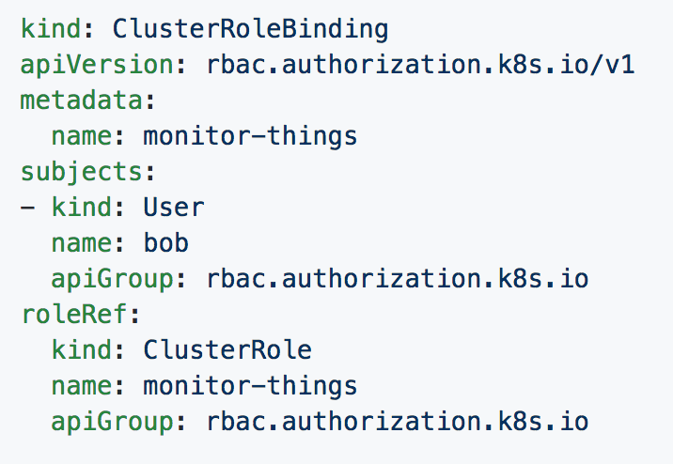
[Cluster]RoleBinding
IV. KEY CONCEPTS (RBAC)
Mapping permission of [Cluster]Role to specific subjects:
User
Group
ServiceAccount
Notes:
This for the most part should be self explanatory

Slide 57

IV. KEY CONCEPTS (RBAC)

Slide 58
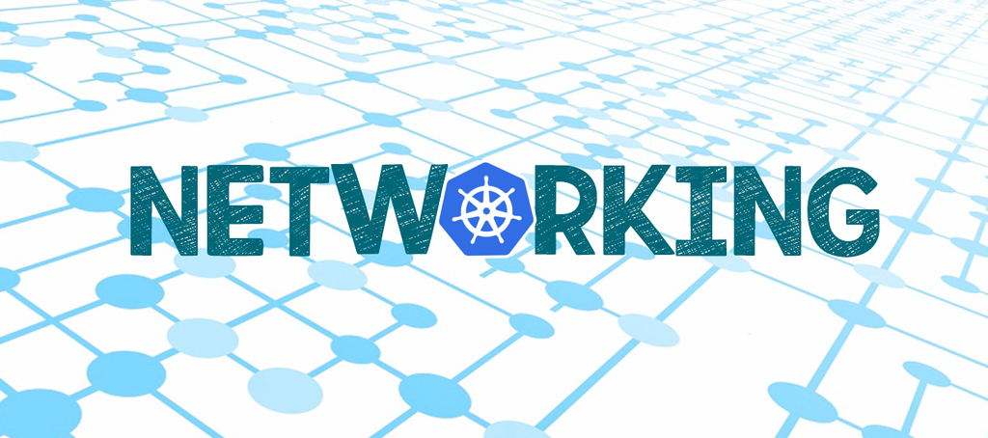

Slide 59

IV. KEY CONCEPTS (Networking)
All Pods can communicate with all other Pods without NAT
All nodes can communicate with all Pods (and vice-versa) without NAT.
The IP that a Pod sees itself as is the same IP that others see it as.
- from Kubernetes’ mother with love -
Notes:
Note: While these are fundamental rules, its quite easy to put network rules in place within k8s to limit pod to pod communication

Slide 60
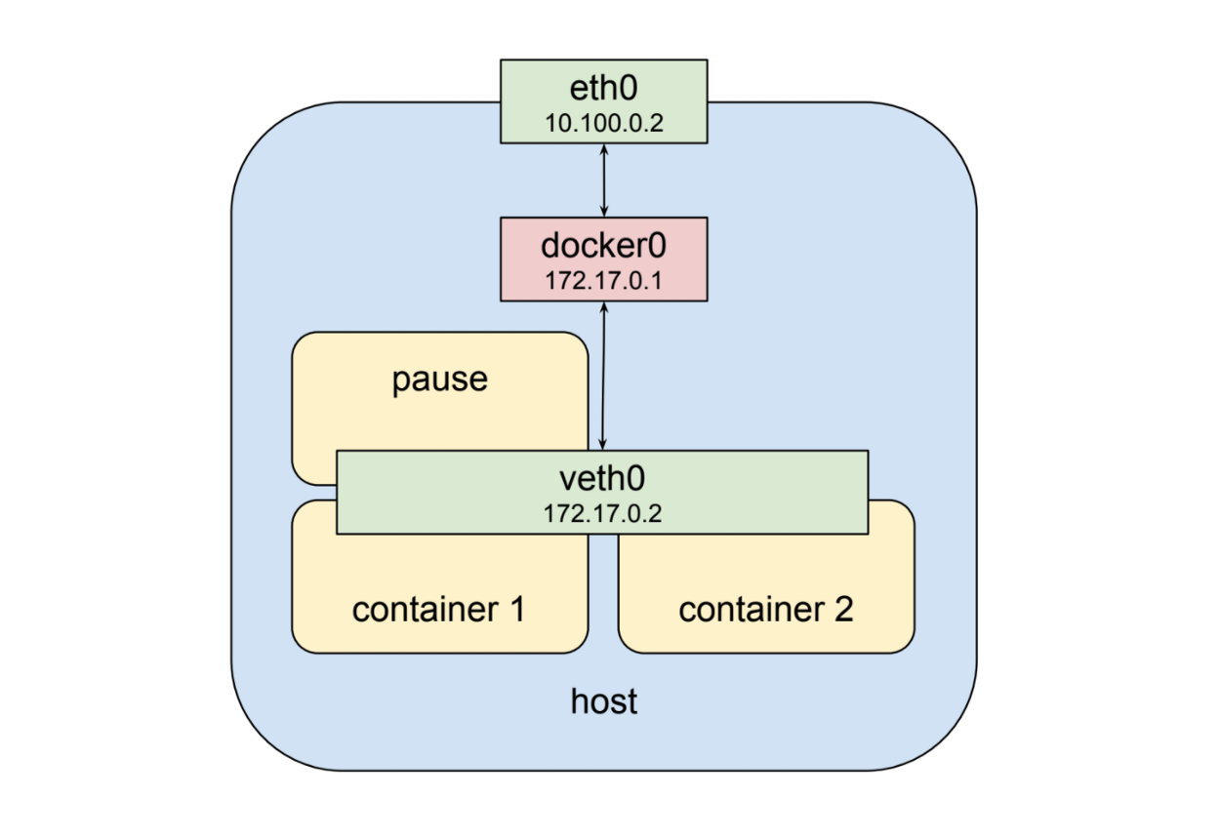
Containers talks in same Pod: + Use the same ClusterIP + Communicate via IPC/not via network
IV. KEY CONCEPTS (Networking)

Slide 61

Pods talks in same Node
IV. KEY CONCEPTS (Networking)

Slide 62

IV. KEY CONCEPTS (Networking)
1) All Pods can communicate with all other Pods without NAT
Pods talks in Kubernetes cluster (1/3)

Slide 63

IV. KEY CONCEPTS (Networking)
Pods talks in Kubernetes cluster (2/3)

Slide 64

IV. KEY CONCEPTS (Networking)
Pods talks in Kubernetes cluster (3/3)

Slide 65
IV. KEY CONCEPTS (Networking)

Slide 66
AGENDA
DOCKER RECALL
KUBERNETES – A RISING HERO
K8S ARCHITECTURE
KEY CONCEPTS
DEMOS
Horizontal Pod Autoscaling (HPA)
Wordpress webpage

Slide 67

IV. DEMO (HPA)
Autoscaling
Resources
Resources
Capacity
Demand
Time
Notes:
Note: While these are fundamental rules, its quite easy to put network rules in place within k8s to limit pod to pod communication

Slide 68

IV. DEMO (HPA)
Kubelet daemon on each node collect information metrics (RAM,CPU,..) about pods
→ Sent back to Metrics Server (on Master node) for making decision (scale-up/scale-down)

Slide 69
AGENDA
DOCKER RECALL
KUBERNETES – A RISING HERO
K8S ARCHITECTURE
KEY CONCEPTS
DEMOS
Horizontal Pod Autoscaling (HPA)
Wordpress webpage

Slide 70

IV. DEMO (webpage requirement)
Setup Kubernetes cluster on AWS EC2, including etcds, master, workers (nodes)
Deploy a WordPress site on Kubernetes with default page at /
Use Ingress for load balancing in Kubernetes
User request http://<dns_site>/careers, the browser will be redirected to default page (at /)

Slide 71
IV. DEMO (webpage analysis)
AWS as cloud-provider
Kubernetes cluster setup (master/workers)
Wordpress container (deploy on all worker)
Backend storage for wordpress (EFS volume1)
Mysql container as database
Backend storage for mysql (EFS volume2)
Ingress/Ingress controller for loadbalancing & path-based routing

Slide 72


Slide 73
QUESTIONS & a little ANSWERS

Slide 74
… something more

Slide 75



THANK YOU FOR ALL OF UNFORGETABLE MEMORIES, LDE !!!

Slide 76


Slide 77
AGENDA
I. DOCKER RECALL
Microservice & Container approach
Docker
II. KUBERNETES – A RISING HERO
Why K8S
What is K8S
III. K8S ARCHITECTURE
Master Components
Node Components
Additional Services
IV. KEY CONCEPTS
Pod/Deloyment/Service
Storage
ConfigMap/Secret
Authenticate and Identity with RBAC
Networking
V. DEMOS
Horizonal Pod Autoscaling
Webpage deployment

Slide 78
IV. KEY CONCEPTS
Annotation - Key-value pairs that contain non-identifying information or metadata. Annotations do not have the the syntax limitations as labels and can contain structured or unstructured data.
Namespace – A logical cluster of environment. Primary method of dividing a cluster or scoping access.
Notes:
Labels, Annotations, and Selectors are heavily used in K8s
Part of the design principles of kubernetes was being able to reference other objects without having to know the object’s name directly and all these play into it
Annotations are used quite a bit by various extensions for additional config information

